Slide 1

WELCOME

Slide 2
Supervisor: Christian Baumgartner, TECO Germany
1. Day :
Morning: - Coagulation Theory (optional)
- First Installation of instrument
- Operation and service functions
- Hidden Functions
- Maintenance Routine
- Firmware Update
- Practical tutorial on instrument
Afternoon - TECAM Tutorial
(installation, create worklists ,receive results, make reports, quality control, connect to LIS, workflow scenarios)
2. Day :
Morning: - Replacement of components
- QC Quality Check
- Typical problems
Afternoon: - Pratical training on instrument
- Final exam
3. Day : (optional)
- TECAM TUTORIAL
- Application Training
( Calibration, QC & Test Protocol)
The „Certificate Of Service“ will be hand over to those who pass the final exam.
Only the certificate will authorize you for servicing TECO instruments.
So please pay attention during the training and ask if something isn‘t clear for you.
Remember that there are no stupid questions but only stupid answers!

Slide 3
What is haemostasis?
Haemostasis is a balanced interaction of blood cells, vascular system, plasma proteins and low molecular substances to impede
BLEEDING OR THROMBOSIS

Slide 4
Haemostasis does
Impede the loss of blood
Keep the blood flowing
Repair injured vasculature or tissue

Slide 5
The three phases of haemostasis
Injury
Primary Hemostasis
Vasoconstriction
Platelet adhesion
Platelet aggregation
(Platelet=Thrombocytes)
( minutes )
Coagulation
Activation of coagulation factors
( Coagulation cascade)
Formation of a fibrin ( minutes )
Fibrinolysis
lysis of the clot
( cleavage of fibrin by plasmin to degradation products i.e. D-Dimer)
Healing

Slide 6
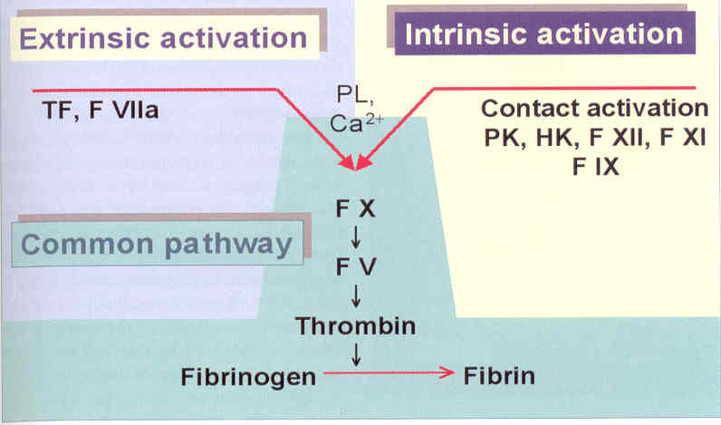
The coagulation cascade
For activation of factor FII, FVII, FIX, FX the presence of Vitamin K is needed
Extrinsic activation by tissue factor ( Thromboplastin )
Intrinsic activation by negative charged surfaces ( Calcium Ions )

Slide 7
Clotting Assays
measures the time in which plasma starts to clot after adding a start reagent
Global tests: PT check extrinsic pathway system
aPTT check instrinsic pathway system
FIB determine fibrinogen concentration
Activation
( start of test )
Thrombin
Fibrinogen
Fibrin
( start of clot reaction )
( end of clot reaction )
Main Activators:
Thromboplastin ( extrinsic, PT )
CaCl
( intrinsic ,APTT )
Thrombin ( FIB )
Detection :
Mechanical
steel ball, change
of magnetic field
Optical
change of light
absorbance
Result:
time upto clot
( PT normal ~ 12s
APTT normal ~ 35s
FIB normal ~ 12s)

Slide 8
Optical detection principle
Clotting time = time to turn-point
The signal amplitude at the end-point is linear proportional to the concentration of
fibrinogen -> derived fibrinogen !!

Slide 9
Prothrombin Time (PT)
begin of
practical
part
Test for the function of the entire extrinsic pathway
The start reagent is Thromboplastin.
The test procedure is: 50µL sample +
100µL Thrombinreagent ( P25)
The expected clotting time for normal healty samples is ~12s

Slide 10
Activated Partial Thromboplastin Time ( APTT)
Test for the function of the entire intrinsic pathway
The start reagent is CaCl
The test procedure is: 50µL sample +
50µL aPTT reagent ( P31) +
incubate 3min +
50µL CaCl ( P26)
The expected clotting time for normal healty samples is ~30s

Slide 11
Fibrinogen according to Clauss ( FIB)
Test is used to determine the concentration of fibrinogen
The start reagent is Thrombin
The test procedure is: 10µL sample +
90µL Owren‘s Buffer ( P38) +
50µL Thrombinreagent ( P29)
The result is expressed in mg/dL or g/L
The expected value for normal healty samples is 180 – 350 mg/dL

Slide 12
First Installation
Remove transport protection on printer and needle
Install
  full rinse container and tube
  printer paper
  cuvettes
Switch on instrument
Confirm „replace rinse tank“
Run cleaning procedure
Check XYZ adjustment
Control temperature
Print a service report 2x .
( Keep one for yourself and fix the other on the rear casing)

Slide 13
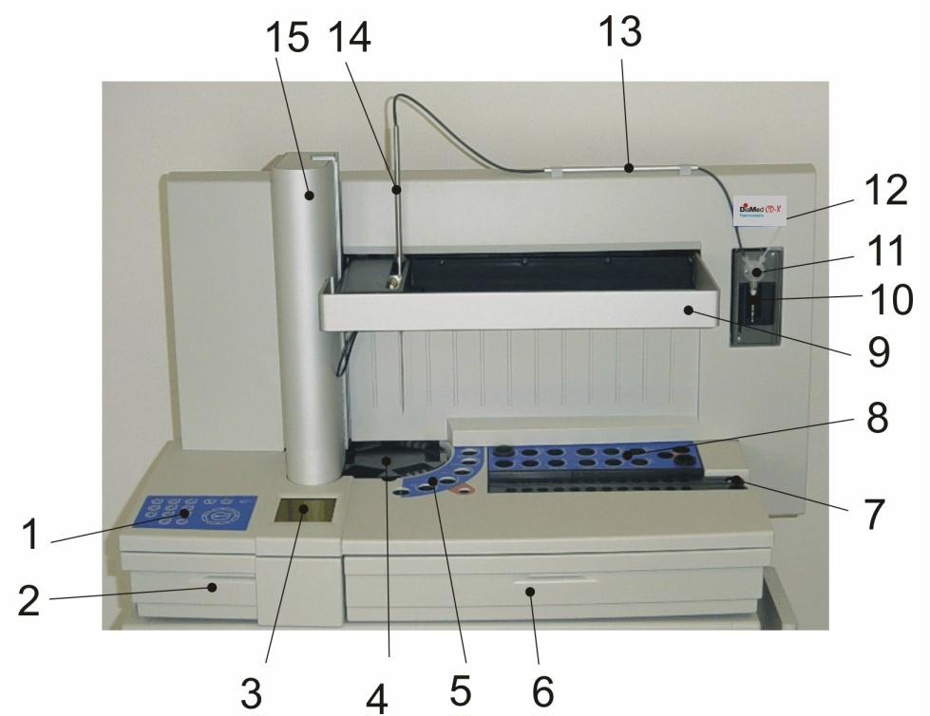
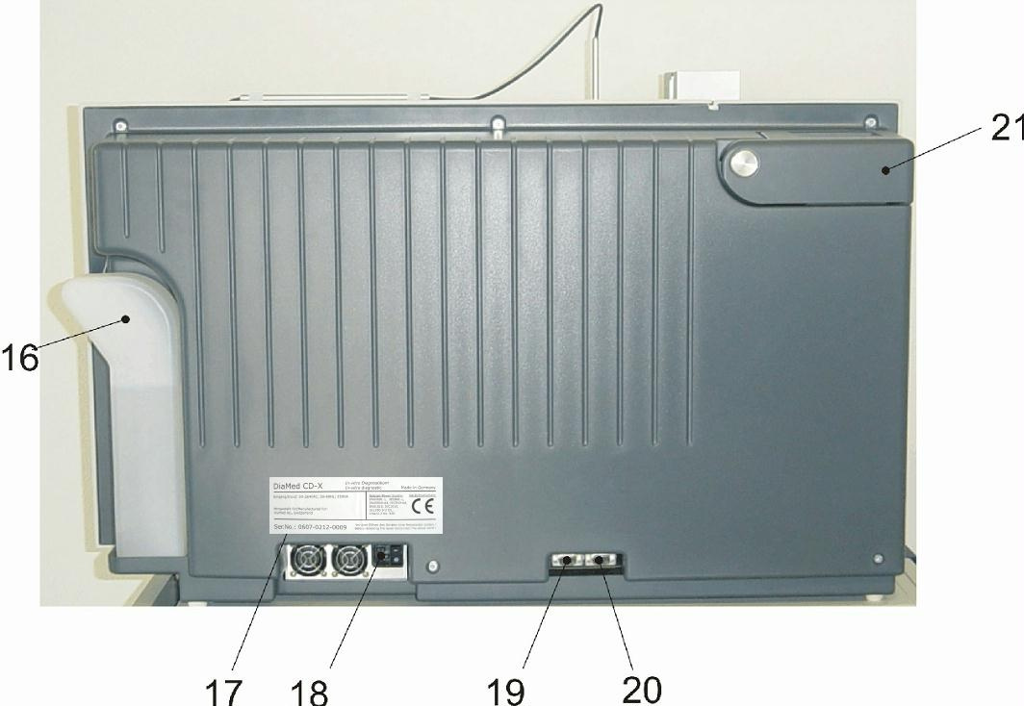
instrument overview

Slide 14
Operation and service functions
Hidden boot menu
  Power off instrument
  Press key “0”continously while switching on the instrument
  Release key “0”,if hidden boot menu appears.
  Press key “0” to start instrument in ADMIN mode.
press key „0“
„Admin mode active“

Slide 15
Operation and service functions
Main menu
Statusbar:
time=12:00
rinse in container= 1055mK
host connection = H0 ( no host)
temperatur at P25 = 37°C .

Slide 16
Operation and service functions
Analysis menu

Slide 17
Operation and service functions
Test Setup menu
key „0“
(if admin)
key „0“
( hidden test menu 1)
( hidden test menu 2)

Slide 18
Operation and service functions
Service menu
key „0“
(if admin)
( Hidden service menu )

Slide 19

Precautions:
maintenance
Avoid direct contact with samples and sample residues in the used cuvettes.
Wear medical infection grade protective gloves for all cleaning and maintenance works involving potential contact with infectious liquids and use each pair of gloves once only.
Use a hand disinfectant product, e.g. Sterilium®, to disinfect your hands after completion of the work.

Slide 20
Replacement instructions: Spare parts
practical
part
Tube system
Needle Probe
Wash Position
Syringe seal
Diluter valve
Insulation block
Shield
Mainboard
Required Tools:
Screwdriver , 1 - 4
Screwdriver , 1 - 4
Flat wrench , 5.5. - 13
Allen wrench, 2 – 5

Slide 21
Replacement instructions: optics
practical
part
Remove back casing ( 6 screws )
Remove protection shield ( 2 screws )
Remove front case ( 4+5 screws )
Unplug keyboard and display
Remove top case ( 7 screws )
Remove cuvette rotation plate
Open two screws and lift optic.
Unplug and remove optics ( 2 screws).
Required Tools:
Screwdriver , 1 - 4
Screwdriver , 1 - 4
Flat wrench , 5.5. - 13
Allen wrench, 2 – 5

Slide 22
Yearly maintenance
practical
part
  Replace needle
  Replace syringe seal
  induction tube
  insulation block
  cleaning position.
  Every 5years the battery of the mainboard (Li-Mn CR 2430)
  Clean and decontaminate working area
  Perform a system quality check
  Print a service report 2x
  (Keep one for yourself and fix the other on the rear casing)

Slide 23
Firmware Update
practical
part
  save calibration data by printing setup of all tests
  save system data by printing a service report
  connect service port to Windows PC ( crossed serial Sub-D9 female )
  switch on instrument
if Visual Basic Scripting is installed and enabled:
  Insert service CD and browse to „CDX Flash Disk“
  start script „click here to flash“
  Enter firmware ( eg. A4010401 =A4 V 1.04.01) and com port
else
  Copy folder „CDX Flash Disk) from CD to local drive
  start batch file „update.bat“ and follow dialogue
Reboot and restore test calibration and system data manually

Slide 24
System Quality Check
practical
part
Must be carried out after replacement of: - electronic parts
- robotor unit
- optic unit
Power supply
Barcode Scanner
Cuvette transportation
Optic
Temperature
Robotics
Real wet test PT ( aPTT & FIB only for manufacturer)
Burn-In test (only for manufacturer)
Final test

Slide 25
Typical problems

Slide 26
Case study: customer complains about „+++“ PT result
Check if rinse tank is not empty
Check if tube fittings are fixed leakfree to valve
Check if needle is not clogged
Check if syringe move smooth and properly
Check XYZ adjustment
Run service „Clean Needle“ -> observe if instrument do correct
Check optic
Check levelsensor ( empty vials and finger-test)
Run wet test PT with a normal control
  - observe if instrument pipet correct
  - Check optic signal during measurement. An increase indicates a clotting reaction
  - After measurement, remove that cuvette and check if there are correct volumes inside
  - Check also with a small pen, if the plasma was really clotted.
if you get results of ~12s than the instrument is working correct.
10. Check out other possibilities:
  - the reagent ( expired or low reactive )
  - sample ( really no clot, or too lipemic, icteric or hemolytic )
  - test setup -> increase maxtime
  - test protocol -> false positions or volumes

Slide 27
Final Exam
practical
part
Theory: 60 min ( 30 points)
Pratical:120 min (65 points)
Find all problems on instrument and perform a system quality check afterwards.
You need 55 points to pass the test. Good luck.

